Slide 1
CZ2006 DS2
Group JAWHO
Price Comparison App for Online Shopping
Members:
Grace Ong
Joelle Thng
Li Haocheng
Luo Wenyu
Wang Anyi

Slide 2
Table of Contents
01
04
02
05
03
06
Expected Users
SE Practices
Class Diagram + Use Case Diagram
Overview of System Design
Supporting Further Upgrades
Live Demo

Slide 3
Expected Users
People who
Shop online often
Want to compare prices so they can get the best deal

Slide 4
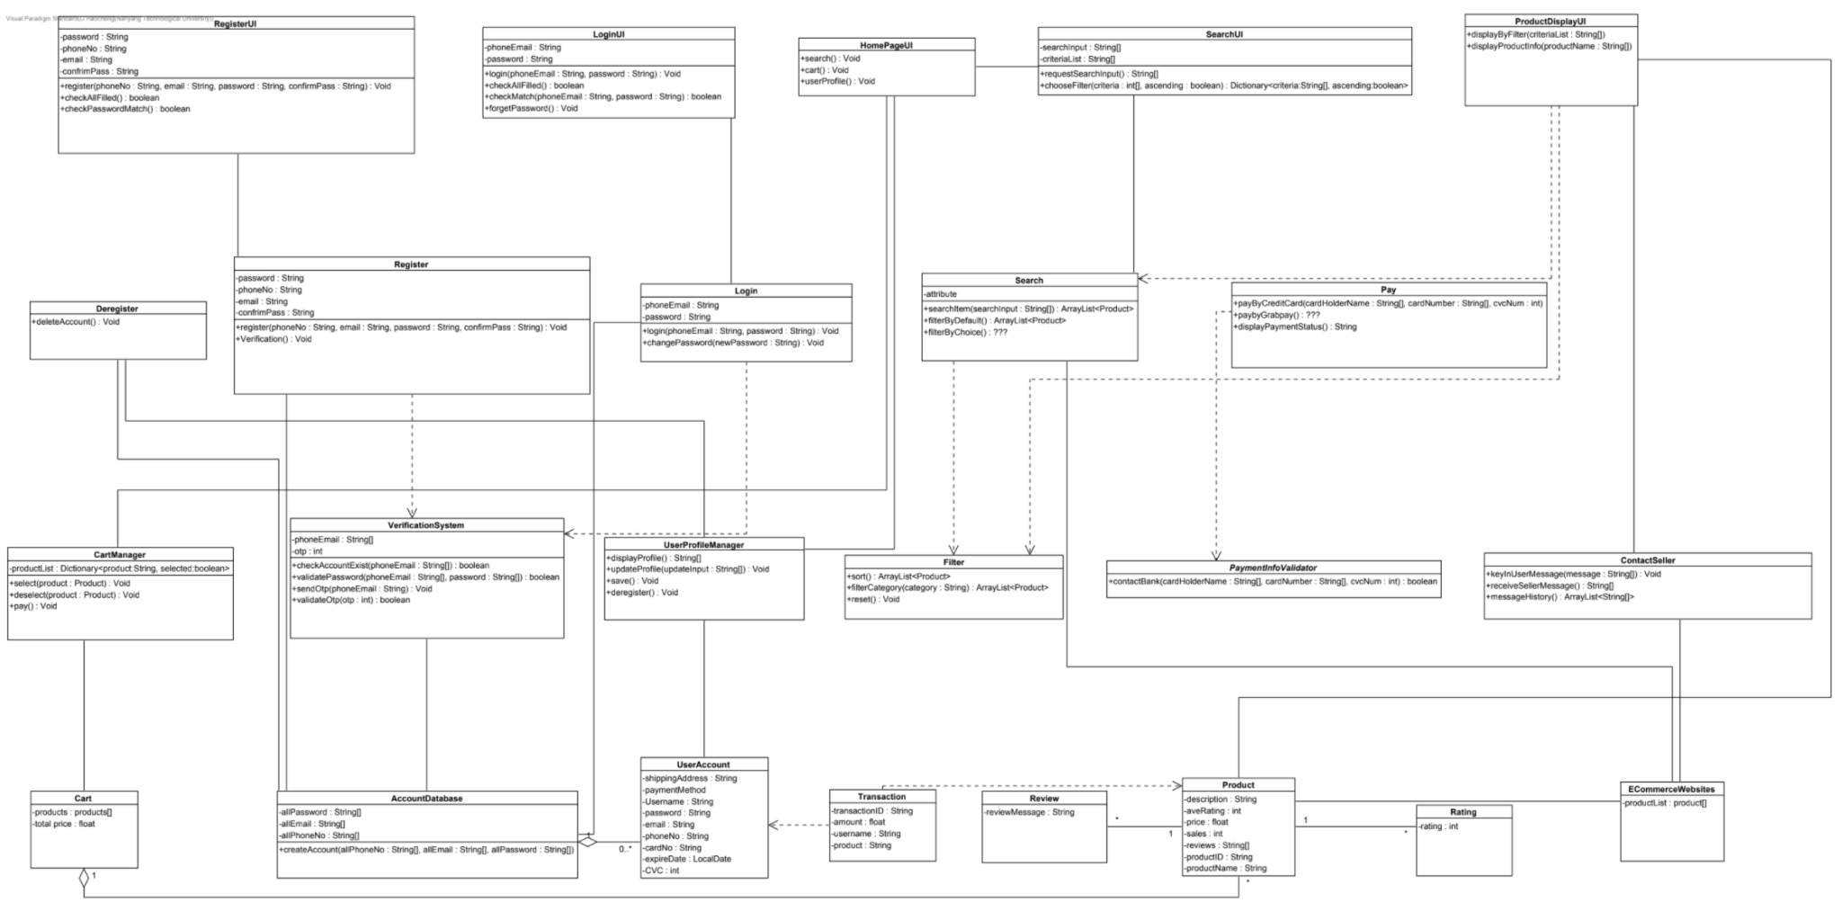
Class Diagram

Slide 5
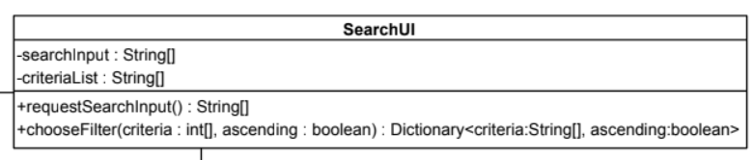
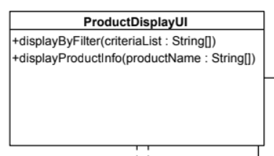
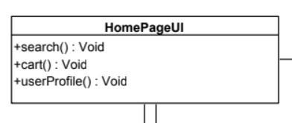
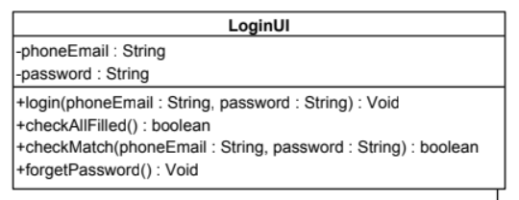
Key Classes (Boundary)

Slide 6
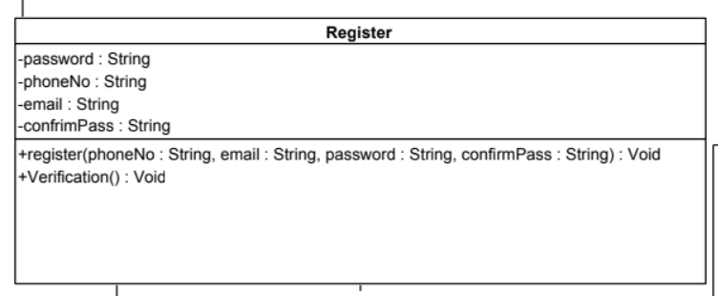
Key Classes (Control)

Slide 7
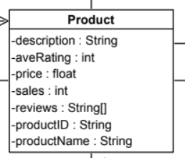
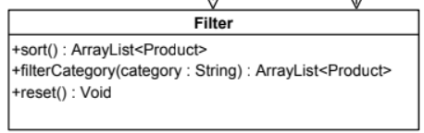
Key Classes (Entity)

Slide 8
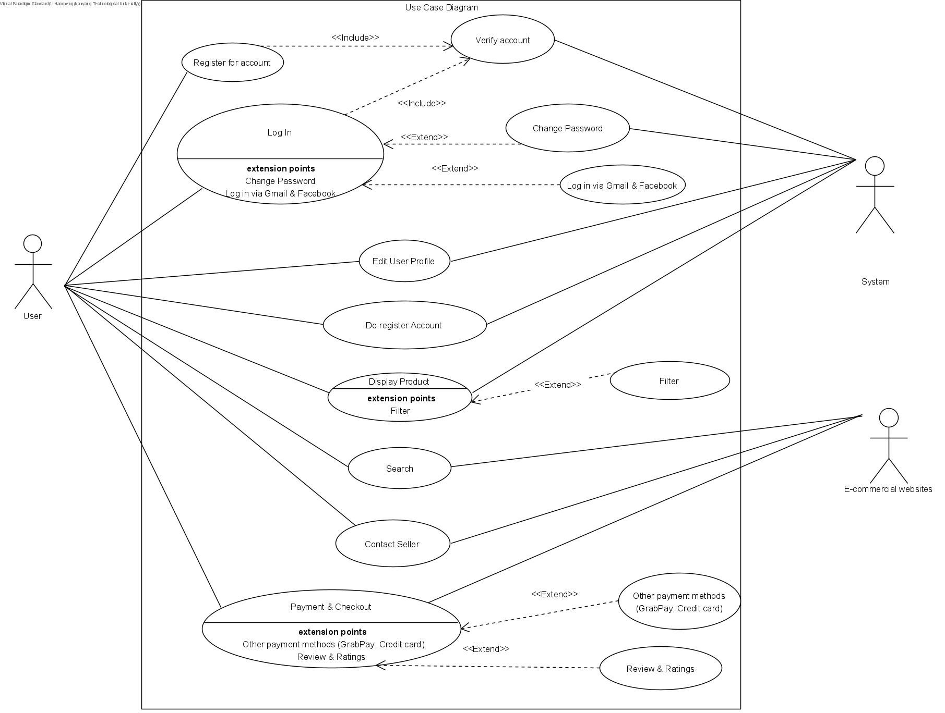
Use Case Diagram

Slide 9
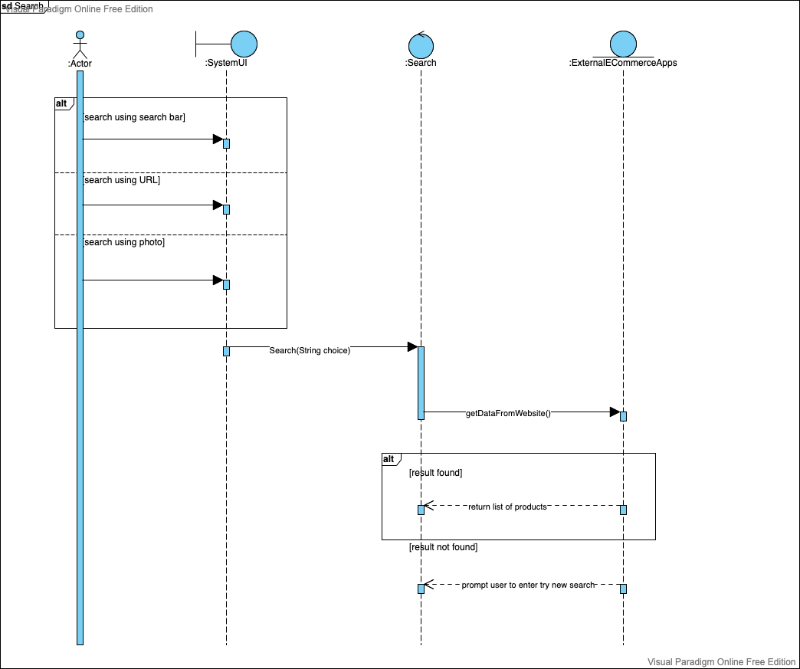
Sequence Diagrams (Key functions)

Slide 10
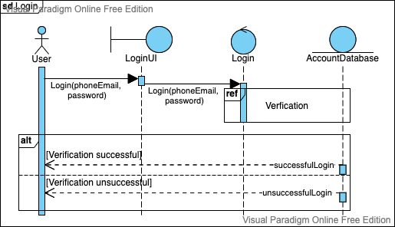
Sequence Diagrams (Key functions)

Slide 11
Live Demo

Slide 12
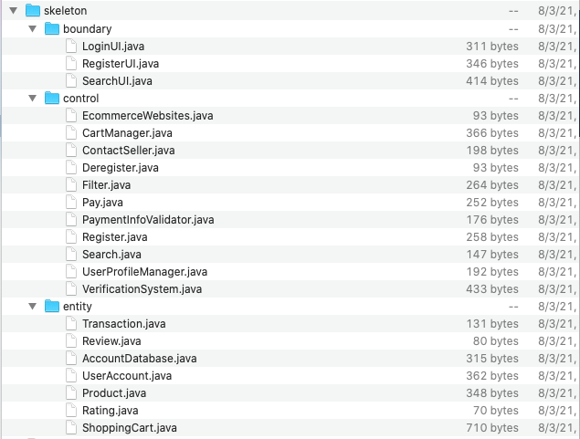
Overview of System Design

Slide 13
Thank you!

